Slide 1
Grouping and Segmentation
03/01/10
Computer Vision
CS 543 / ECE 549
University of Illinois
Derek Hoiem
https://courses.grainger.illinois.edu/cs543/sp2011/

Slide 2
Last week
EM
Mixture of Gaussians
Segmentation using EM and graph cuts

Slide 3
Today’s class
Segmentation and grouping
Gestalt cues
By clustering (mean-shift)
By boundaries (watershed)

Slide 4
Gestalt grouping

Slide 5
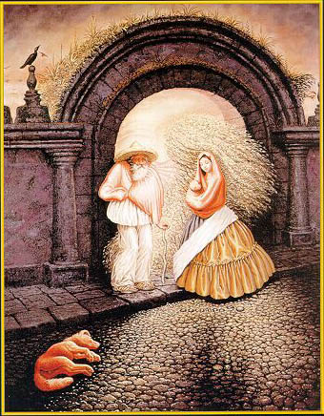

Slide 6
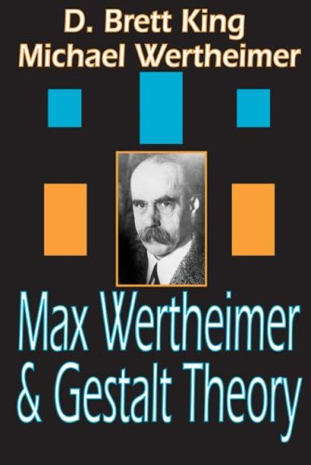
Gestalt psychology or gestaltism
German: Gestalt - "form" or "whole”
Berlin School, early 20th century
Kurt Koffka, Max Wertheimer, and Wolfgang Köhler
View of brain:
whole is more than the sum of its parts
holistic
parallel
analog
self-organizing tendencies
Slide from S. Saverese

Slide 7
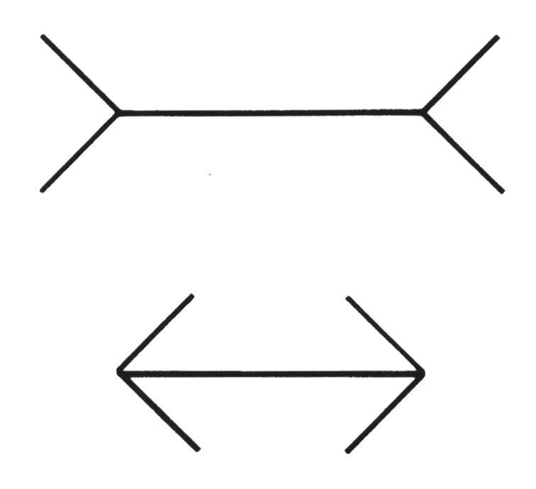
Gestaltism
The Muller-Lyer illusion
Notes:
The famous Muller-Lyer illusion; the point is that the horizontal bar has properties that come only from its membership in
a group (it looks shorter in the lower picture, but is actually the same size) and that these properties can’t be discounted--- you can’t look at this figure and ignore the arrowheads and thereby make the two bars seem to be the same size.

Slide 8
We perceive the interpretation, not the senses
Notes:
In one experiment, children from rural Zambia were less susceptible to the illusion.

Slide 9
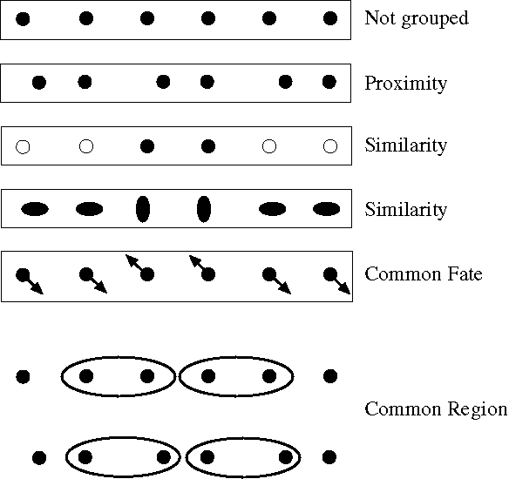
Principles of perceptual organization
From Steve Lehar: The Constructive Aspect of Visual Perception
Notes:
Some criteria that tend to cause tokens to be grouped.

Slide 10
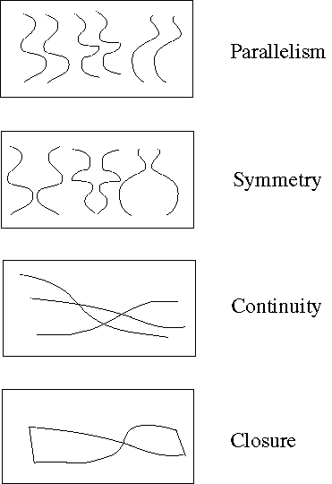
Principles of perceptual organization
Notes:
More such

Slide 11
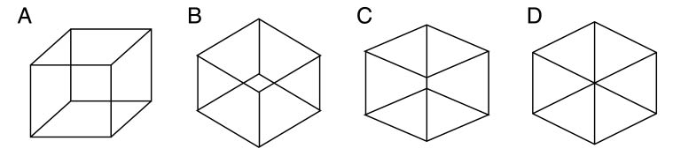
Gestaltists do not believe in coincidence

Slide 12
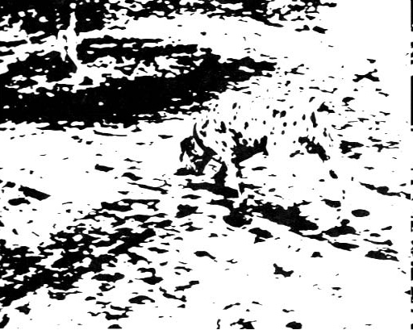
Emergence

Slide 13
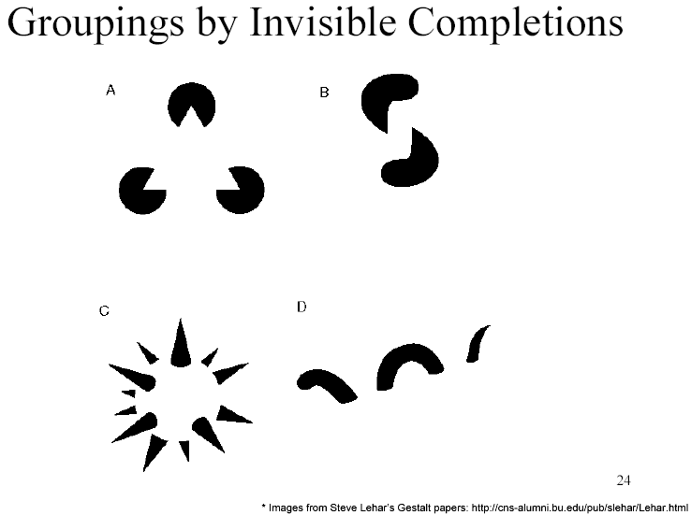
Grouping by invisible completion
From Steve Lehar: The Constructive Aspect of Visual Perception

Slide 14
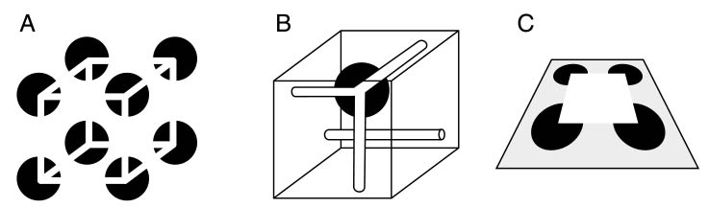
Grouping involves global interpretation
From Steve Lehar: The Constructive Aspect of Visual Perception

Slide 15
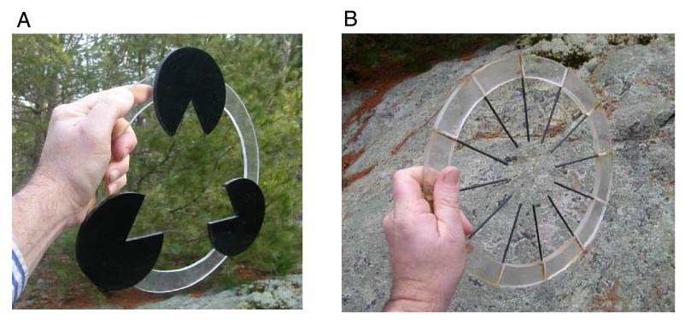
Grouping involves global interpretation
From Steve Lehar: The Constructive Aspect of Visual Perception

Slide 16
Gestalt cues
Good intuition and basic principles for grouping
Basis for many ideas in segmentation and occlusion reasoning
Some (e.g., symmetry) are difficult to implement in practice

Slide 17
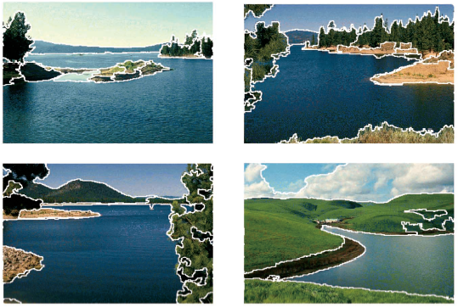
Moving on to image segmentation …
Goal: Break up the image into meaningful or perceptually similar regions

Slide 18
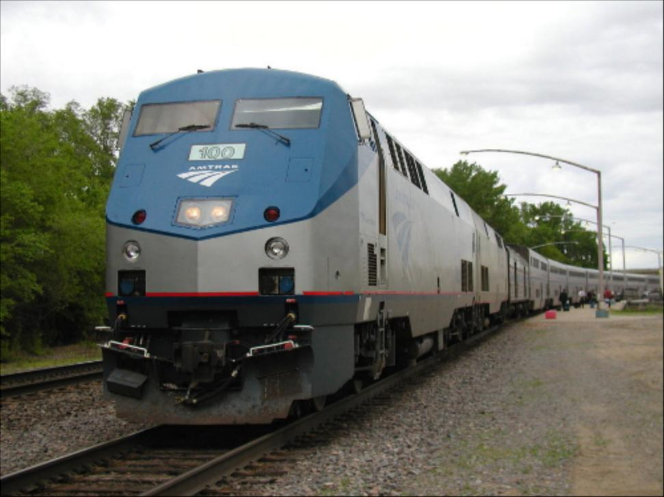
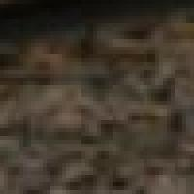

Segmentation for feature support
50x50 Patch
50x50 Patch

Slide 19
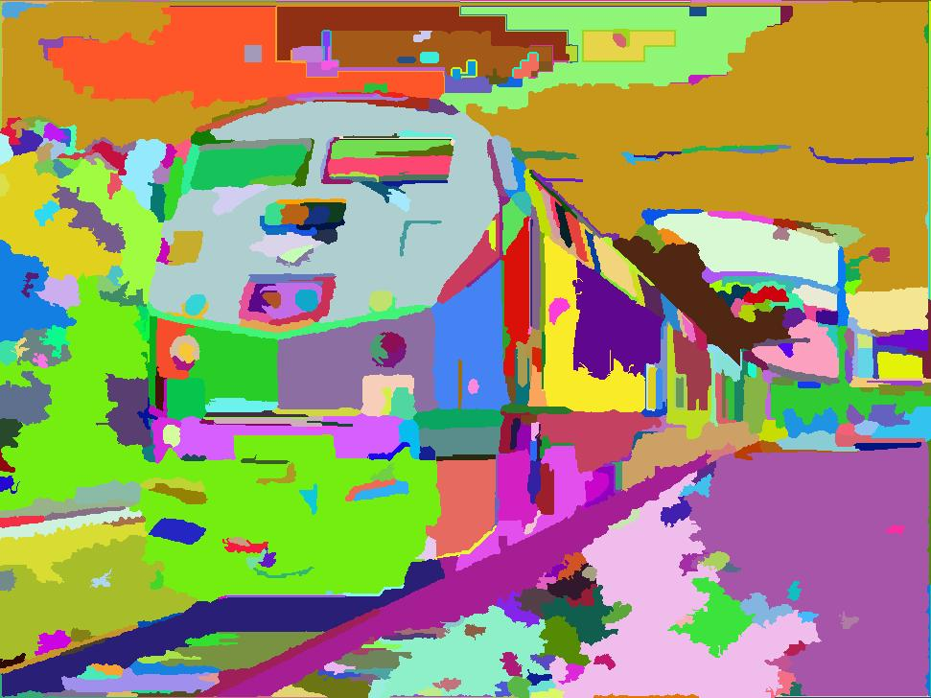
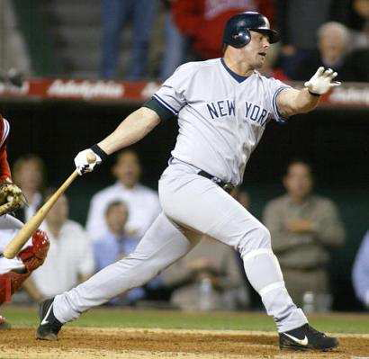
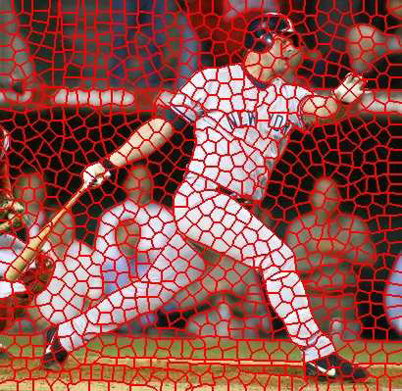
Segmentation for efficiency
[Felzenszwalb and Huttenlocher 2004]
[Shi and Malik 2001]
[Hoiem et al. 2005, Mori 2005]

Slide 20
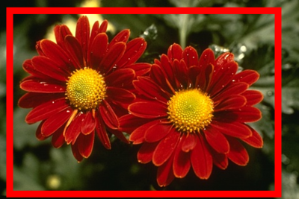
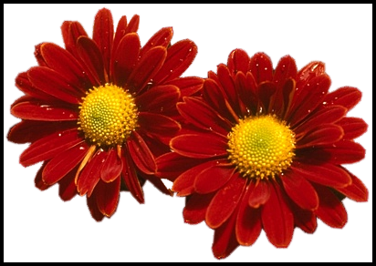
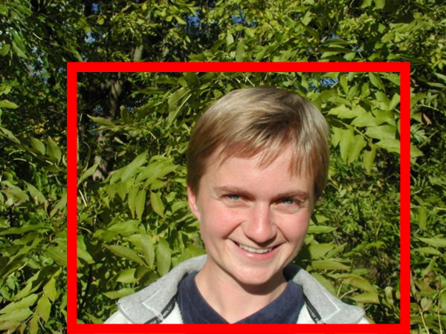
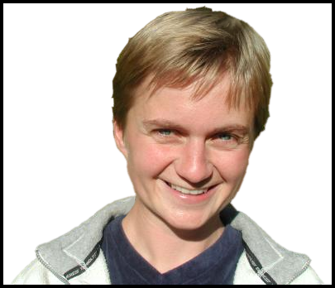
Segmentation as a result
Rother et al. 2004

Slide 21
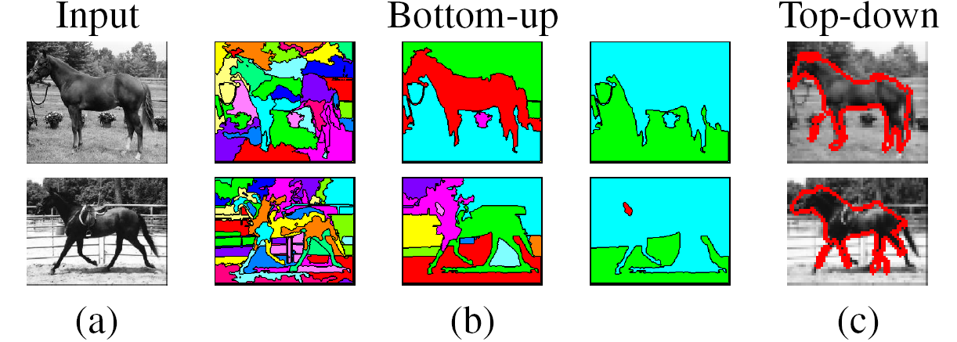
Types of segmentations
Oversegmentation
Undersegmentation
Multiple Segmentations

Slide 22
Major processes for segmentation
Bottom-up: group tokens with similar features
Top-down: group tokens that likely belong to the same object
[Levin and Weiss 2006]

Slide 23
Segmentation using clustering
Kmeans
Mean-shift

Slide 24
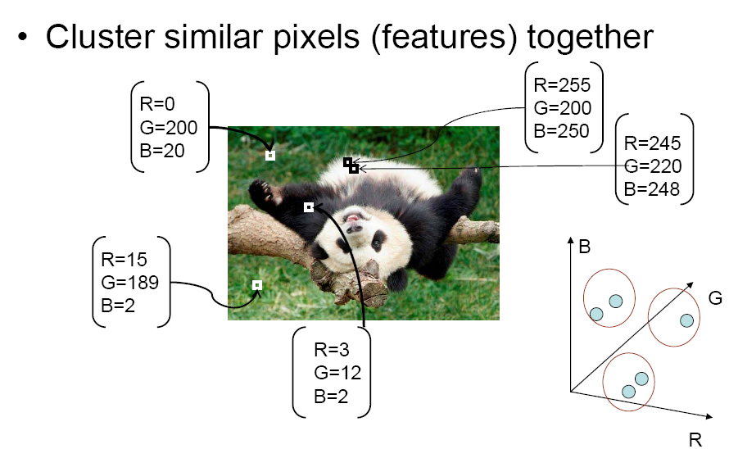
Feature Space
Source: K. Grauman

Slide 25
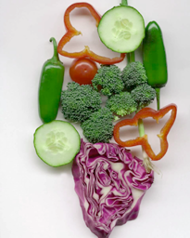
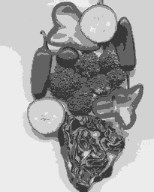
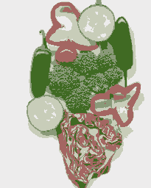
K-means clustering using intensity alone and color alone
Image
Clusters on intensity
Clusters on color
Notes:
I gave each pixel the mean intensity or mean color of its cluster --- this is basically just vector quantizing the image intensities/colors. Notice that there is no requirement that clusters be spatially localized and they’re not.

Slide 26
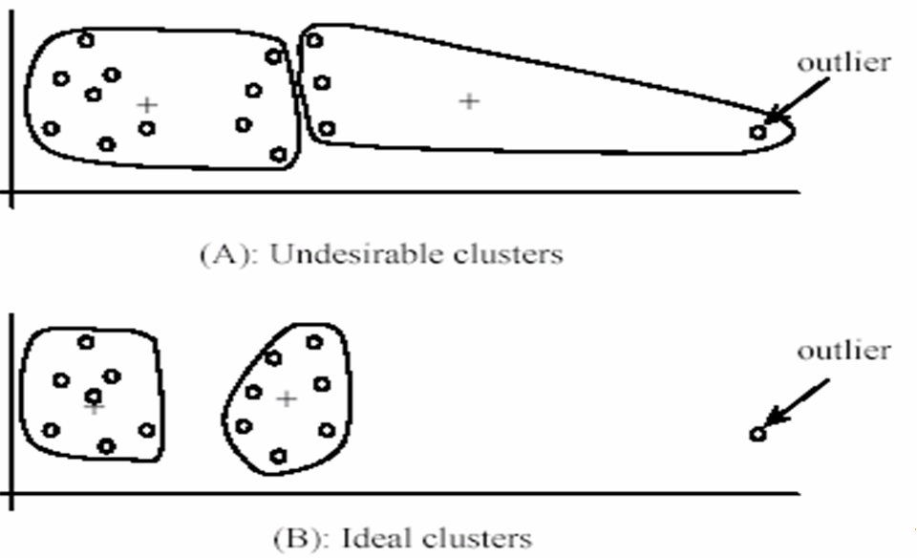
K-Means pros and cons
Pros
Simple and fast
Easy to implement
Cons
Need to choose K
Sensitive to outliers
Usage
Rarely used for pixel segmentation

Slide 27
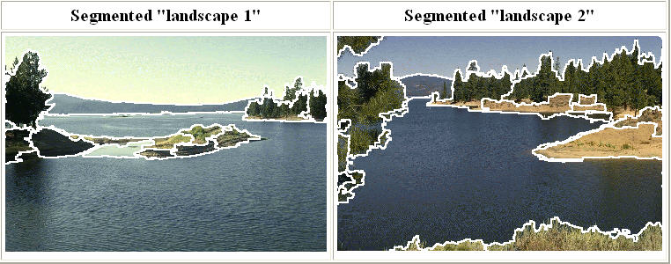
Mean shift segmentation
D. Comaniciu and P. Meer, Mean Shift: A Robust Approach toward Feature Space Analysis, PAMI 2002.
Versatile technique for clustering-based segmentation

Slide 28
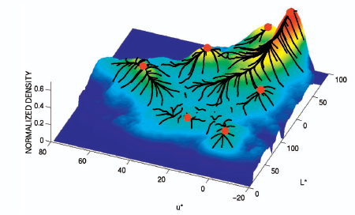
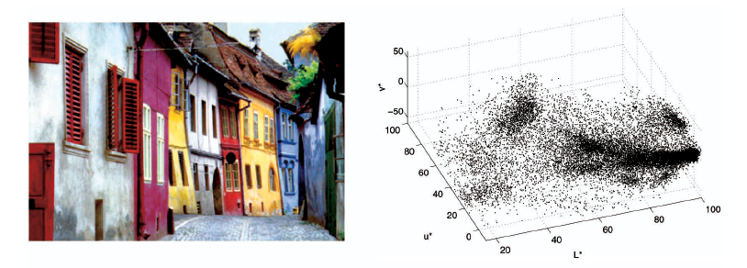
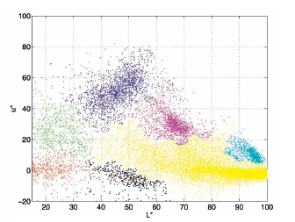
Mean shift algorithm
Try to find modes of this non-parametric density

Slide 29
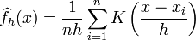
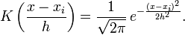
Kernel density estimation
Kernel density estimation function
Gaussian kernel

Slide 30
Mean shift
Region of
interest
Center of
mass
Mean Shift
vector
Slide by Y. Ukrainitz & B. Sarel

Slide 31
Mean shift
Region of
interest
Center of
mass
Mean Shift
vector
Slide by Y. Ukrainitz & B. Sarel

Slide 32
Mean shift
Region of
interest
Center of
mass
Mean Shift
vector
Slide by Y. Ukrainitz & B. Sarel

Slide 33
Mean shift
Region of
interest
Center of
mass
Mean Shift
vector
Slide by Y. Ukrainitz & B. Sarel

Slide 34
Mean shift
Region of
interest
Center of
mass
Mean Shift
vector
Slide by Y. Ukrainitz & B. Sarel

Slide 35
Mean shift
Region of
interest
Center of
mass
Mean Shift
vector
Slide by Y. Ukrainitz & B. Sarel

Slide 36
Mean shift
Region of
interest
Center of
mass
Slide by Y. Ukrainitz & B. Sarel

Slide 37
Computing the Mean Shift
Simple Mean Shift procedure:
Compute mean shift vector
Translate the Kernel window by m(x)
Slide by Y. Ukrainitz & B. Sarel

Slide 38
Real Modality Analysis

Slide 39
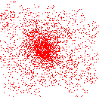
Attraction basin
Attraction basin: the region for which all trajectories lead to the same mode
Cluster: all data points in the attraction basin of a mode
Slide by Y. Ukrainitz & B. Sarel

Slide 40
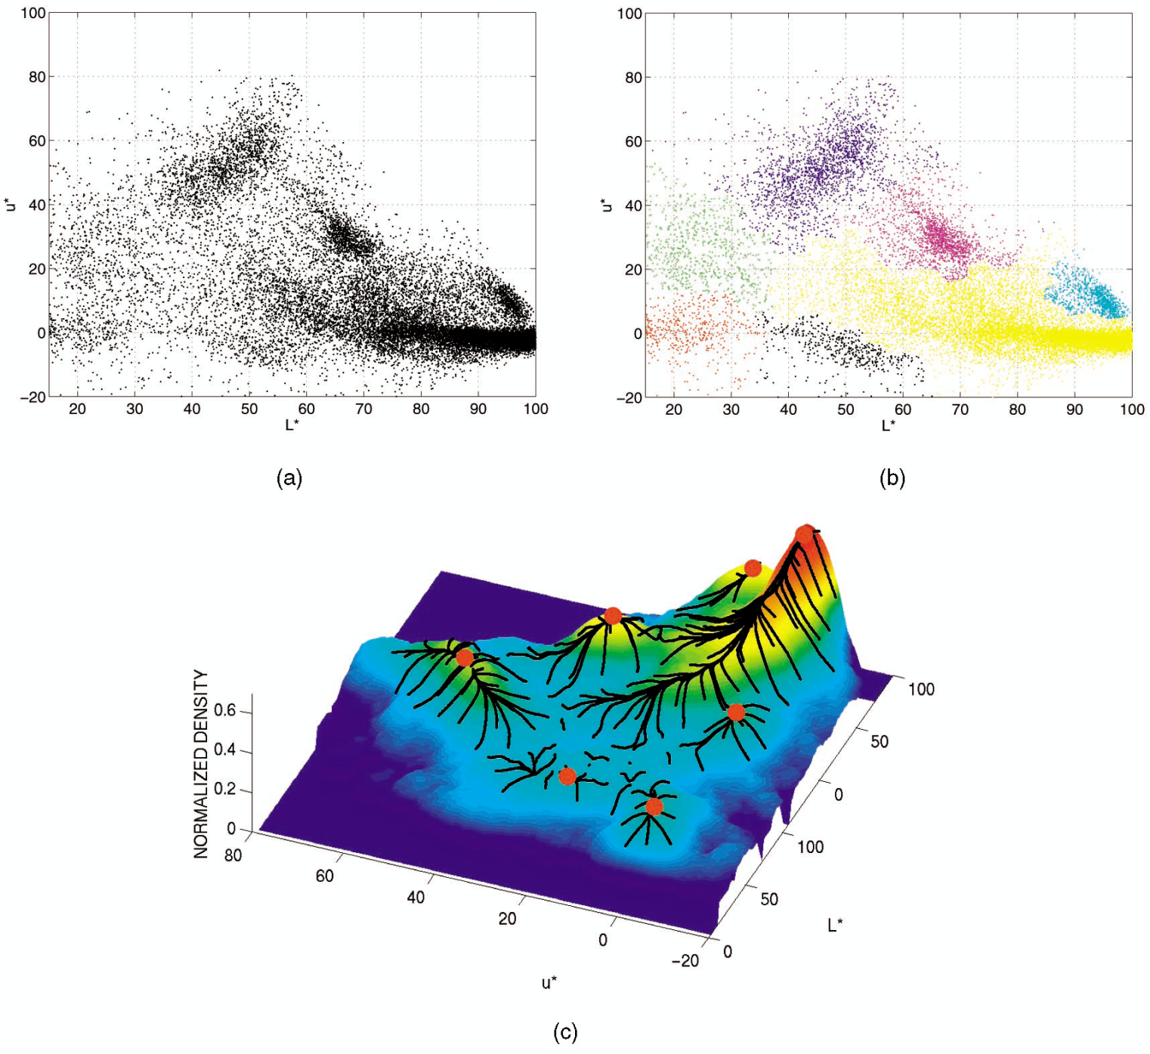
Attraction basin

Slide 41
Mean shift clustering
The mean shift algorithm seeks modes of the given set of points
Choose kernel and bandwidth
For each point:
Center a window on that point
Compute the mean of the data in the search window
Center the search window at the new mean location
Repeat (b,c) until convergence
Assign points that lead to nearby modes to the same cluster

Slide 42

Segmentation by Mean Shift
Compute features for each pixel (color, gradients, texture, etc)
Set kernel size for features K_{f} and position K_{s}
Initialize windows at individual pixel locations
Perform mean shift for each window until convergence
Merge windows that are within width of K_{f} and K_{s}

Slide 43
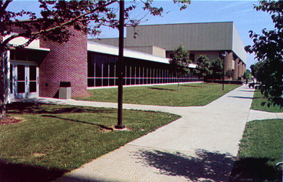
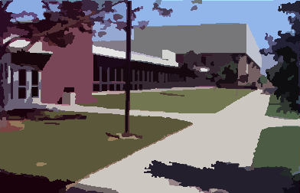
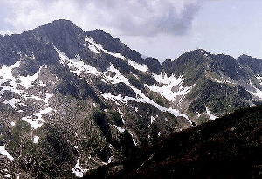
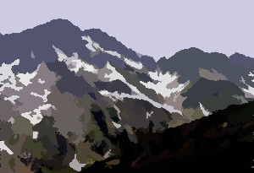
Mean shift segmentation results
http://www.caip.rutgers.edu/~comanici/MSPAMI/msPamiResults.html

Slide 44
http://www.caip.rutgers.edu/~comanici/MSPAMI/msPamiResults.html

Slide 45
Mean-shift: other issues
Speedups
Binned estimation
Fast search of neighbors
Update each window in each iteration (faster convergence)
Other tricks
Use kNN to determine window sizes adaptively
Lots of theoretical support
D. Comaniciu and P. Meer, Mean Shift: A Robust Approach toward Feature Space Analysis, PAMI 2002.

Slide 46
Mean shift pros and cons
Pros
Good general-practice segmentation
Flexible in number and shape of regions
Robust to outliers
Cons
Have to choose kernel size in advance
Not suitable for high-dimensional features
When to use it
Oversegmentatoin
Multiple segmentations
Tracking, clustering, filtering applications

Slide 47
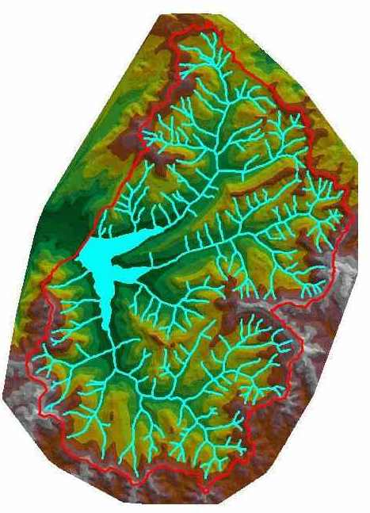
Watershed algorithm

Slide 48

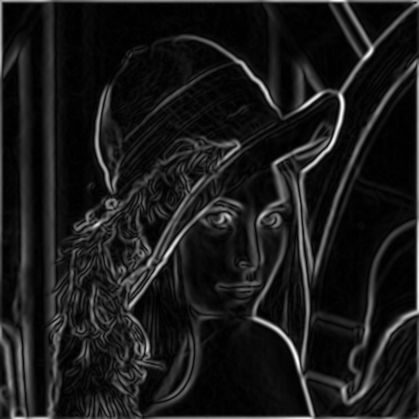
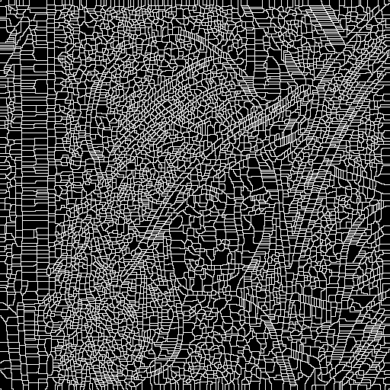
Watershed segmentation
Image
Gradient
Watershed boundaries

Slide 49
Meyer’s watershed segmentation
Choose local minima as region seeds
Add neighbors to priority queue, sorted by value
Take top priority pixel from queue
If all labeled neighbors have same label, assign to pixel
Add all non-marked neighbors
Repeat step 3 until finished
Matlab: seg = watershed(bnd_im)
Meyer 1991

Slide 50
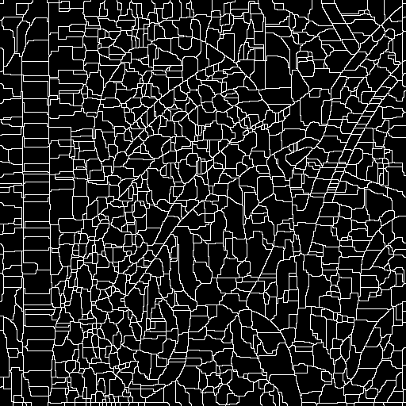
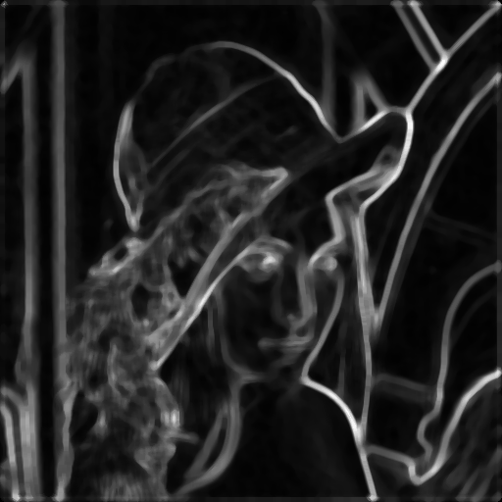
Simple trick
Use Gaussian or median filter to reduce number of regions

Slide 51
Watershed usage
Use as a starting point for hierarchical segmentation
Ultrametric contour map (Arbelaez 2006)
Works with any soft boundaries
Pb
Canny
Etc.

Slide 52
Watershed pros and cons
Pros
Fast (< 1 sec for 512x512 image)
Among best methods for hierarchical segmentation
Cons
Only as good as the soft boundaries
Not easy to get variety of regions for multiple segmentations
No top-down information
Usage
Preferred algorithm for hierarchical segmentation

Slide 53

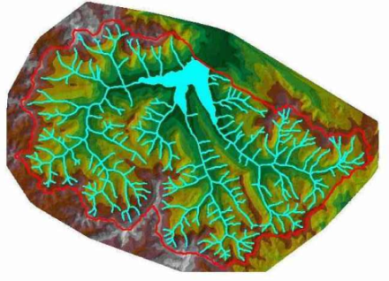
Things to remember
Gestalt cues and principles of organization
Uses of segmentation
Efficiency
Better features
Want the segmented object
Mean-shift segmentation
Good general-purpose segmentation method
Generally useful clustering, tracking technique
Watershed segmentation
Good for hierarchical segmentation
Use in combination with boundary prediction

Slide 54
Further reading
Nicely written mean-shift explanation (with math)
http://saravananthirumuruganathan.wordpress.com/2010/04/01/introduction-to-mean-shift-algorithm/
Mean-shift paper by Comaniciu and Meer
http://www.caip.rutgers.edu/~comanici/Papers/MsRobustApproach.pdf
Adaptive mean shift in higher dimensions
http://mis.hevra.haifa.ac.il/~ishimshoni/papers/chap9.pdf
Contours to regions (watershed): Arbelaez et al. 2009
http://www.eecs.berkeley.edu/~arbelaez/publications/Arbelaez_Maire_Fowlkes_Malik_CVPR2009.pdf

Slide 55
Recap of Grouping and Fitting

Slide 56
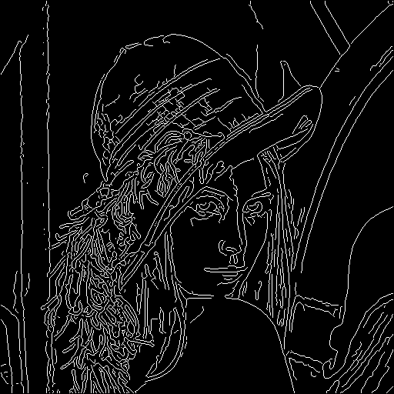
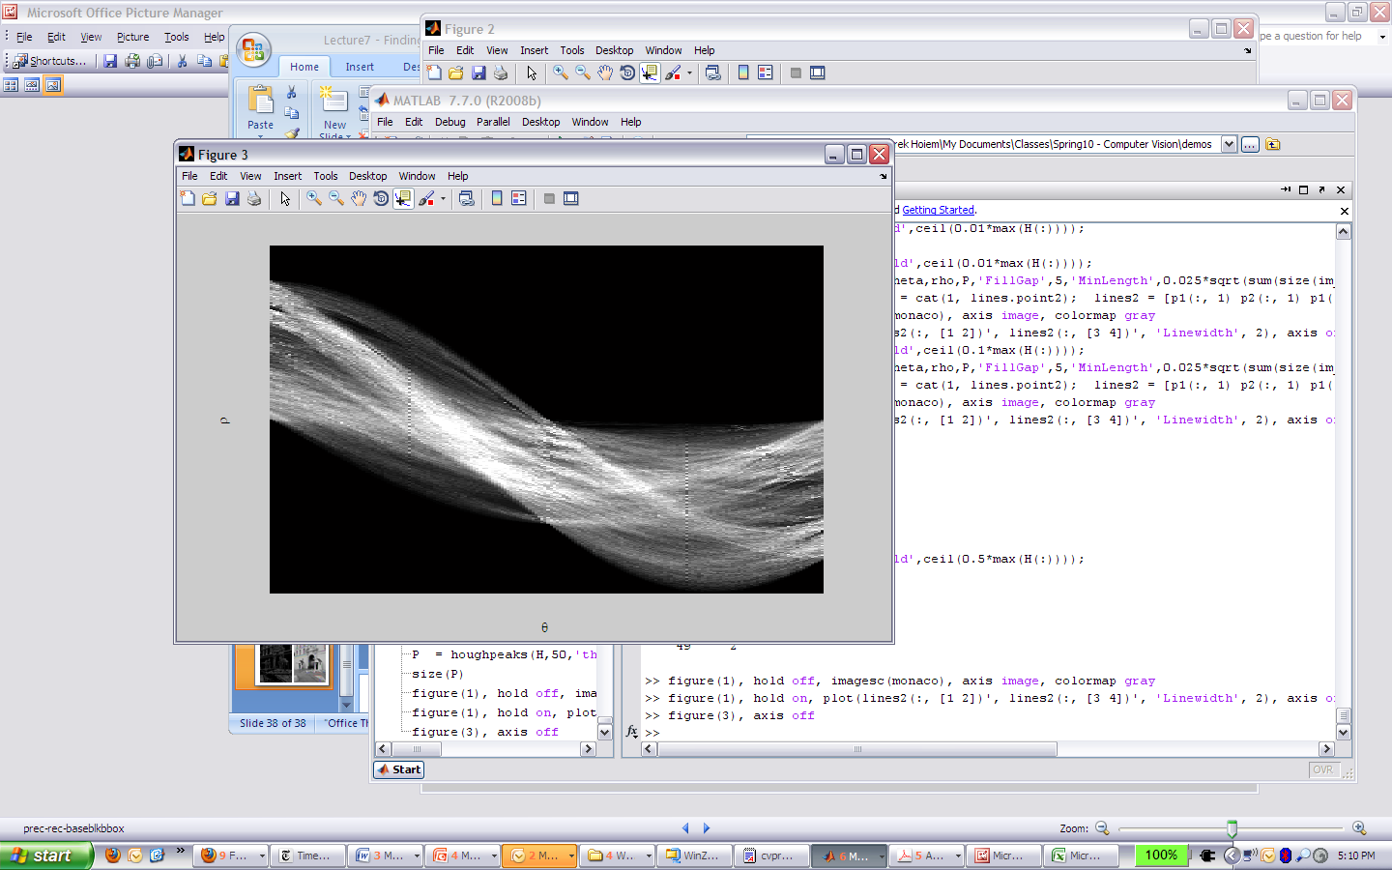
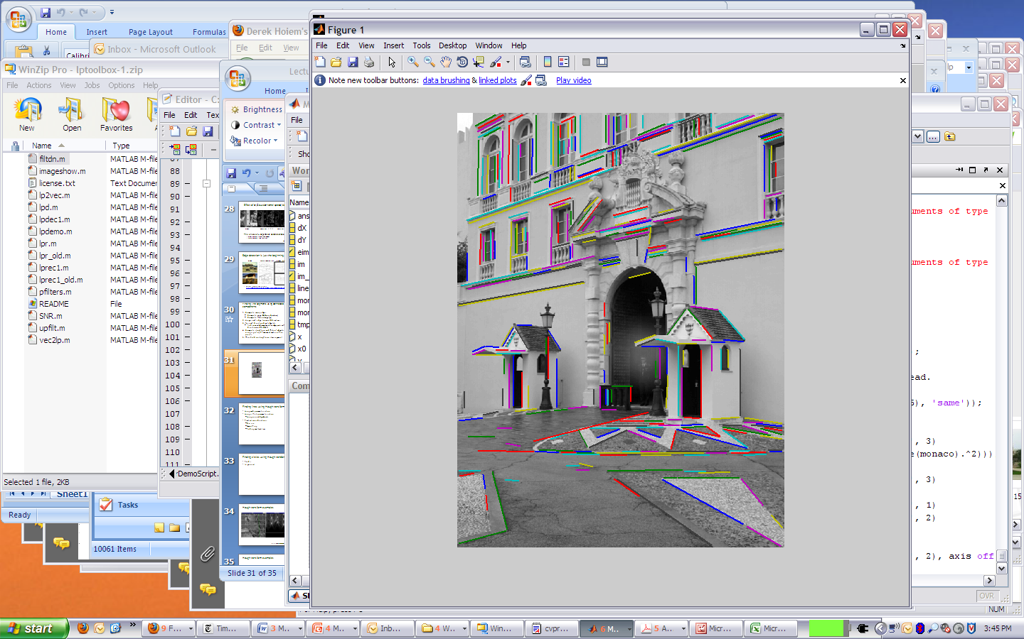
Edge and line detection
Canny edge detector = smooth → derivative → thin → threshold → link
Generalized Hough transform = points vote for shape parameters
Straight line detector = canny + gradient orientations → orientation binning → linking → check for straightness

Slide 57
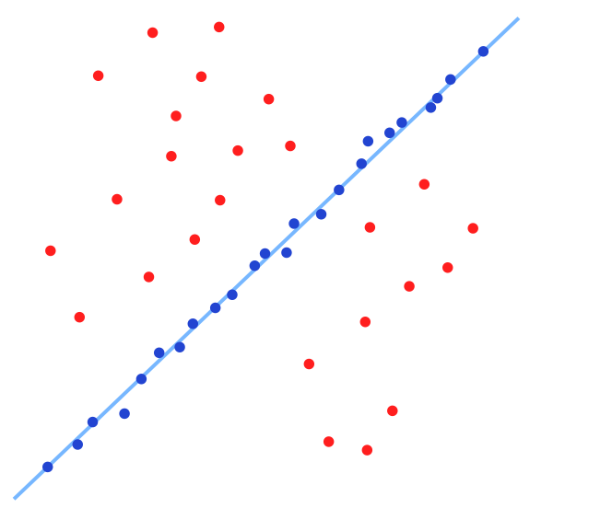
Robust fitting and registration
Key algorithms
RANSAC, Hough Transform

Slide 58
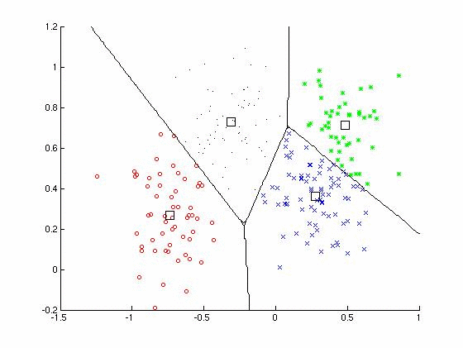
Clustering
Key algorithm
K-means

Slide 59
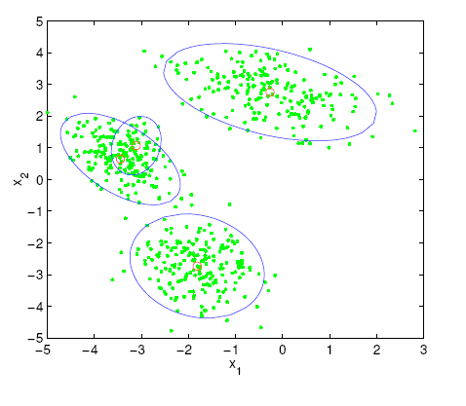
EM and Mixture of Gaussians
Tutorials: http://www.cs.duke.edu/courses/spring04/cps196.1/.../EM/tomasiEM.pdfhttp://www-clmc.usc.edu/~adsouza/notes/mix_gauss.pdf

Slide 60


Segmentation
Mean-shift segmentation
Flexible clustering method, good segmentation
Watershed segmentation
Hierarchical segmentation from soft boundaries
Normalized cuts
Produces regular regions
Slow but good for oversegmentation
MRFs with Graph Cut
Incorporates foreground/background/object model and prefers to cut at image boundaries
Good for interactive segmentation or recognition

Slide 61
Next section: Recognition
How to recognize
Specific object instances
Faces
Scenes
Object categories

